Slide 1
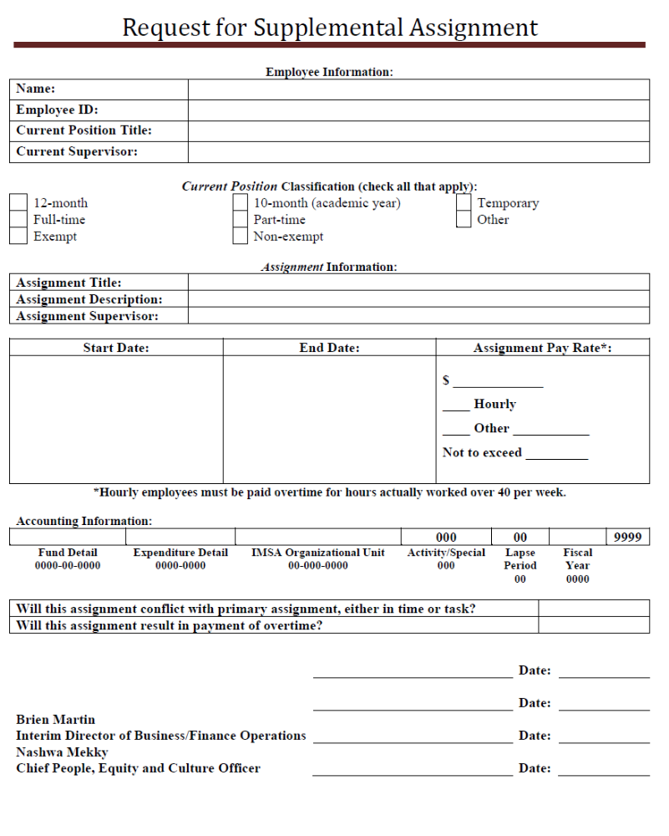
Name of employee performing the additional assignment
If not known, HR will complete.
Employee’s current title.
Employee’s Current Supervisor
Supplemental Title
Brief duty description
Supervisor in charge, will also sign the supplemental timesheet?
Enter start and end dates.
Specify pay rate, including hourly or flat rate details, and any maximum hours or $.
Budget responsible for the supplemental work.
Supplemental work should not interfere with the employee’s normal work duties/schedule.
Enter the name and title of the supplemental assignment supervisor.
Enter the name and title of the supplemental assignment department’s Cabinet member.

